Slide 1
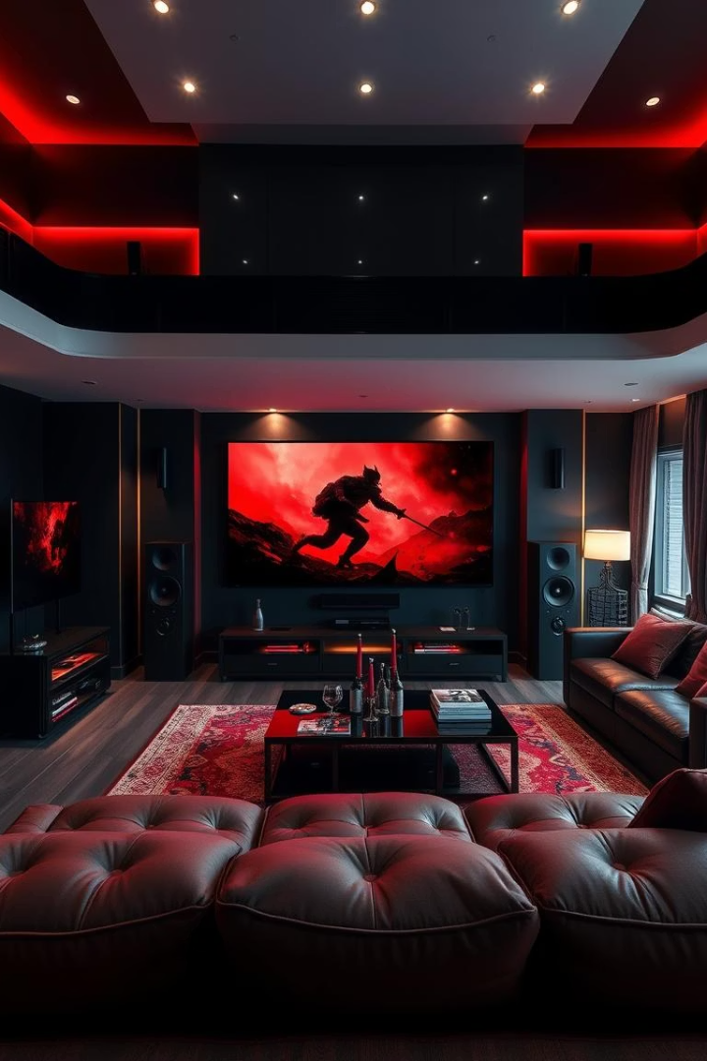
Product Analysis of Flipkart Home Theatre Systems
This presentation details a comprehensive product analysis of home theatre systems available on Flipkart. We explore a range of techniques, from web scraping and data cleaning to machine learning modeling, to extract actionable insights for e-commerce analysts and data scientists. The goal is to uncover patterns and predict product categories, thereby informing strategic decisions.
Name: Naresh Kumar C
Batch: June 2024
Date : 21-04-2025

Slide 2

Project Objective
Data Extraction and Cleaning
Pattern Analysis and Clustering
Extracting relevant data from Flipkart, cleaning inconsistencies, and preparing the data for analysis.
Analyzing patterns in the data, clustering products into meaningful segments, and deriving actionable insights.
Predictive Modeling
Predicting product categories using machine learning models to optimize marketing strategies.

Slide 3

Web Scraping
Tool:SeleniumBeautifulSoup
Target: Flipkart Home Theatre Systems
Extracted Fields
Product Name
Utilizing Selenium and BeautifulSoup for dynamic web scraping capabilities.
Price
Discount
Focusing on extracting data specifically for home theatre systems listed on Flipkart.
Rating
Reviews

Slide 4
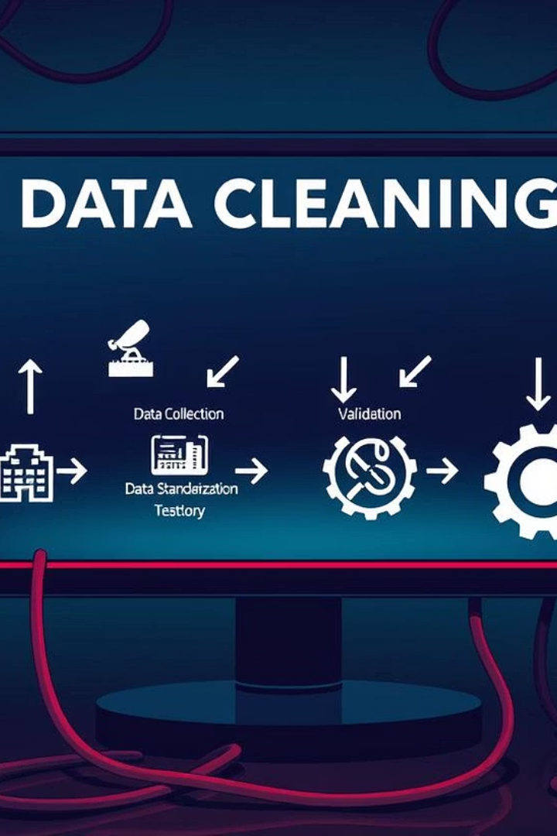
Data Cleaning
Handling Missing Data
Removal of null values and duplicate entries to ensure data integrity.
Standardization
Standardizing currency format and text casing for consistency.
Data Type Conversion
Converting prices and discounts to numeric data types for quantitative analysis.
Validation
Cleaning and validating all fields to maintain data quality and reliability.

Slide 5
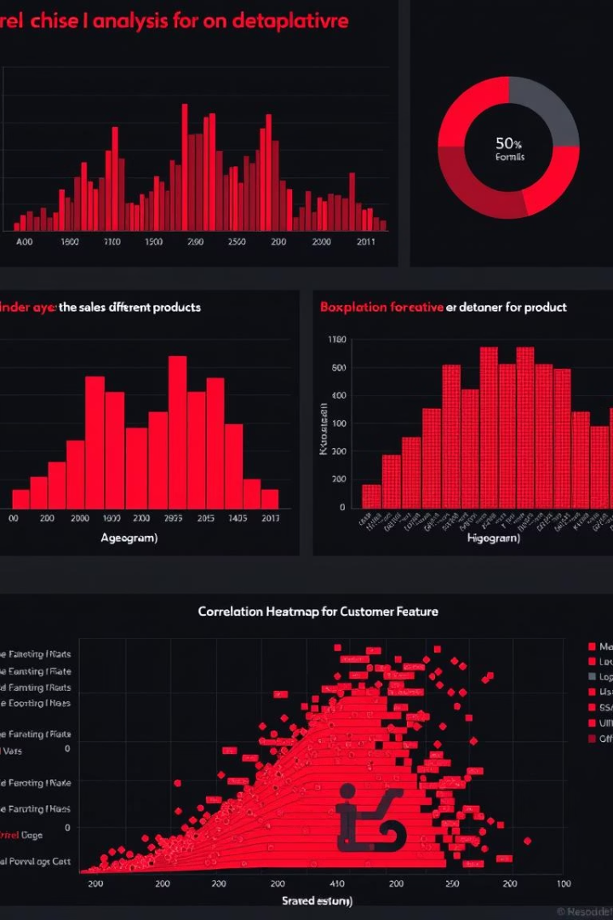



Exploratory Data Analysis
Histograms
Visualizing number of products and discount distributions.
Scatterplot
Comparing rating versus price ranges.
Correlation Heatmap
Identifying feature correlations.

Slide 6





Data Storage
Storage Format
Accessibility
Relational format
Easy access for modeling
Tool Used
Querying
MySQL
Facilitated querying
2
3
1
4
The cleaned dataset was stored in MySQL, a relational database management system. This facilitated easier access for subsequent modeling and querying. Storing data in a relational format ensures data integrity and allows for efficient retrieval and manipulation, which is essential for advanced analytical tasks.

Slide 7
Unsupervised Learning
Algorithm
1
K-Means Clustering
Features
2
Price, Discount, Rating
Evaluation
3
Silhouette Score
K-Means Clustering was employed as the unsupervised learning algorithm, utilizing price, discount, and rating as features. The Silhouette Score was used to determine the optimal number of clusters. Cluster labels were then added to the dataset, providing a basis for segmenting products based on inherent similarities.

Slide 8
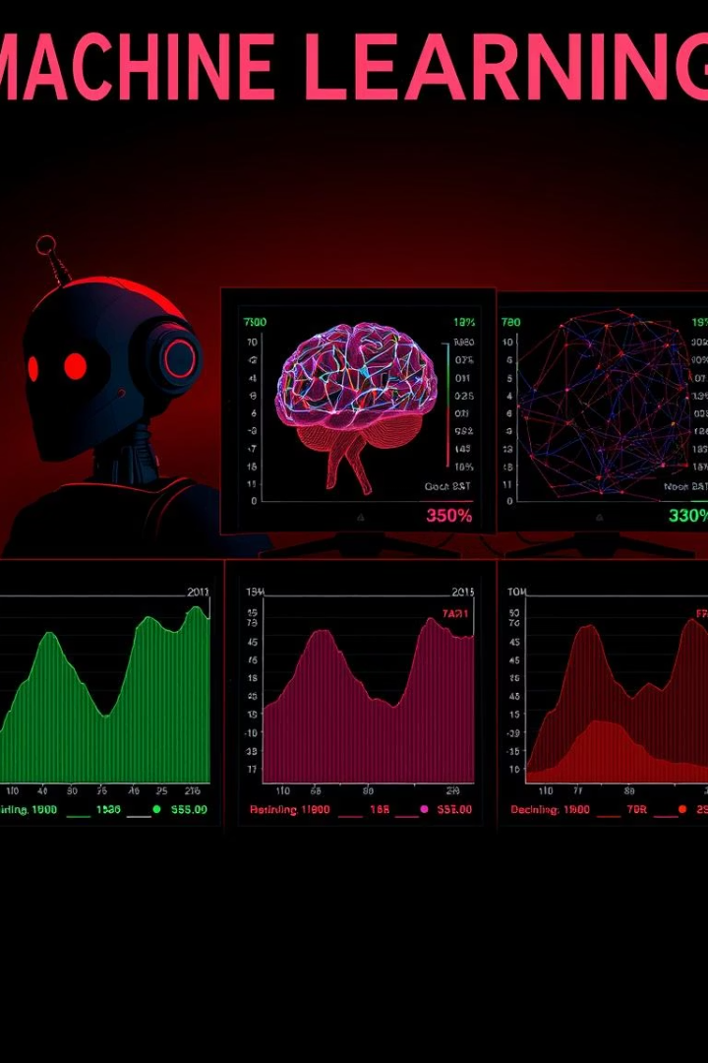
Supervised Learning
1
Target
Cluster labels
2
Models
Logistic Regression, SVM, k-NN, Random Forest, XGBoost
3
Metrics
Accuracy, F1 Score
4
Best Model
Random Forest
For supervised learning, cluster labels were used as the target variable. Several models, including Logistic Regression, SVM, k-NN, Random Forest, and XGBoost, were evaluated using accuracy and F1 score. The Random Forest model emerged as the best performer, showcasing its effectiveness in predicting product categories based on the clustered data.

Slide 9




Hyperparameter Tuning
Tool
Tuned Parameters
Result
GridSearchCV
Improved performance
n_estimators, max_depth, learning_rate
Hyperparameter tuning was performed using GridSearchCV to optimize the Random Forest model. Key parameters such as n_estimators, max_depth, and learning_rate were tuned. This process significantly improved the model's performance, enhancing its ability to accurately predict product categories and generalize to new data.

Slide 10


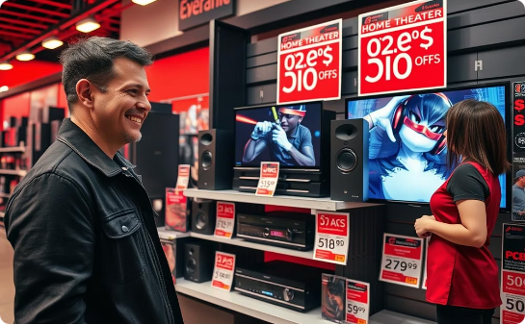
Key Insights
Cluster-Based Grouping
Random Forest Accuracy
Customer Preferences
Identifies valuable pricing segments for targeted marketing.
Preference for mid-range systems with discounts informs pricing and placement.
Accurately predicts product categories for improved recommendations.

Slide 11
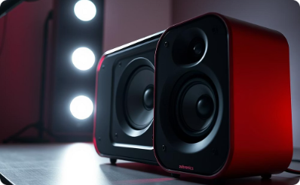
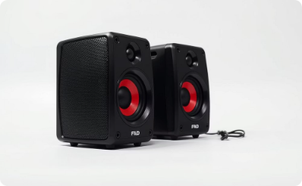
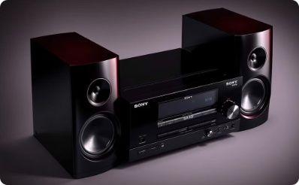
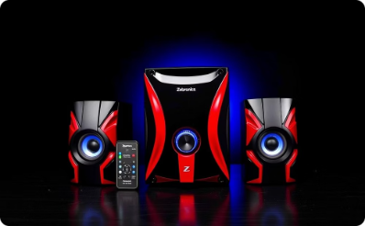
Conclusion:
Best-Selling Home Theatre Products on Flipkart
Zebronics Zeb-Juke Bar 3900
F&D F210X 2.1 Bluetooth Speakers
Sony SA-D40 4.1 Channel Multimedia Speaker
Zebronics BT4440RUCF 4.1 Multimedia Speaker
Price: ₹5,499 | 45% Off
Rating: ⭐ 4.2 | 3,200+ Reviews
Price: ₹2,999 | 40% Off
Rating: ⭐ 4.1 | 2,700+ Reviews
Price: ₹8,490 | 30% Off
Price: ₹3,999 | 50% Off
Rating: ⭐ 4.4 | 4,000+ Reviews
Rating: ⭐ 4.0 | 3,500+ Reviews

